Slide 1
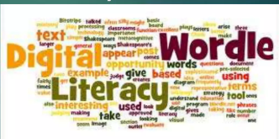
Digital literacy
Abdul Wahab (02-131222-132)
Abdullah Sadiq(02-131222-99)

Slide 2


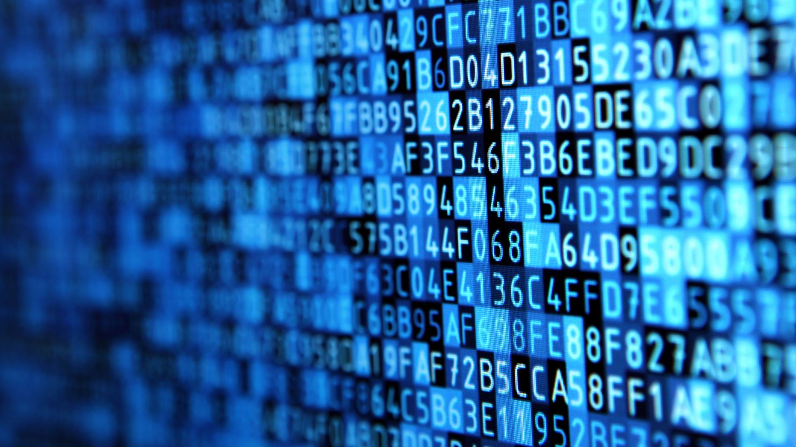



What is Digital Literacy?

Slide 3
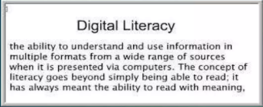
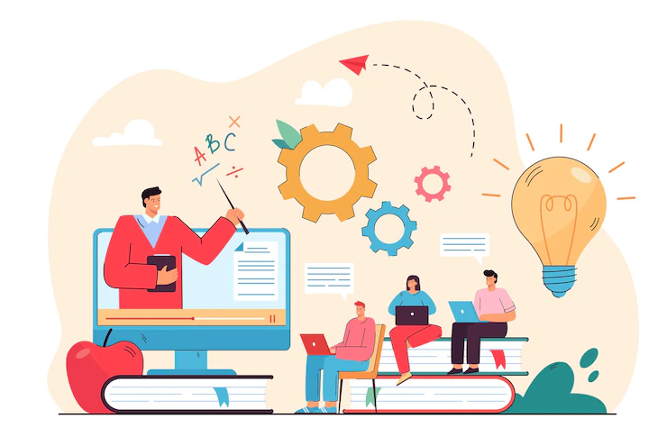
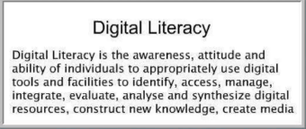

Slide 4
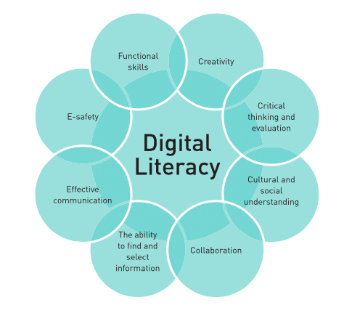
The Eight essential of digital Literacy

Slide 5

Why its improtant
Digital Literacy is an improtant topic because Technology is changing faster than society is.
Digital literacy can improve the academic performance of students by allowing them to create content such as presentations, videos and blog posts.

Slide 6
Information literacy
Determines the nature and extent of information needed.
Accesses the needed information effectively and efficiently.
Evaluation information and its Sources critically and incorporates selected information into his or her knowledge base and value system
Uses information effectively to accomplish a specific purpose.

Slide 7
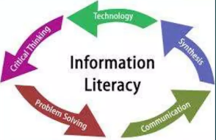
What it is.
Digital literacy means having the skills you need to live, learn, and work in a society where communication and access to information is increasingly through digital technologies like internet platforms, social media, and mobile devices. Developing your critical thinking skills.
Information literacy can no longer be defined without considering technology literacy in order for individuals to function in an information-rich, technology-infused world.

Slide 8
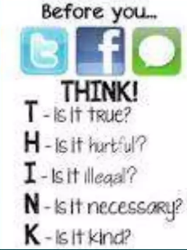
Digital citizenship
Uses these skills to actively participate in civic society and contribute to a vibrant, informed, and engaged community.
Digital citizenship is the norms of appropriate, responsible technology use.

Slide 9
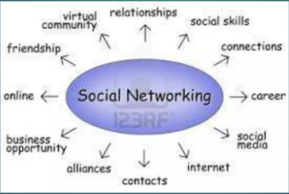
Social Networking
Uses this skills and the appropriate technology to communicate and collaborate with peers, colleagues, family, and on occasion the general public.

Slide 10
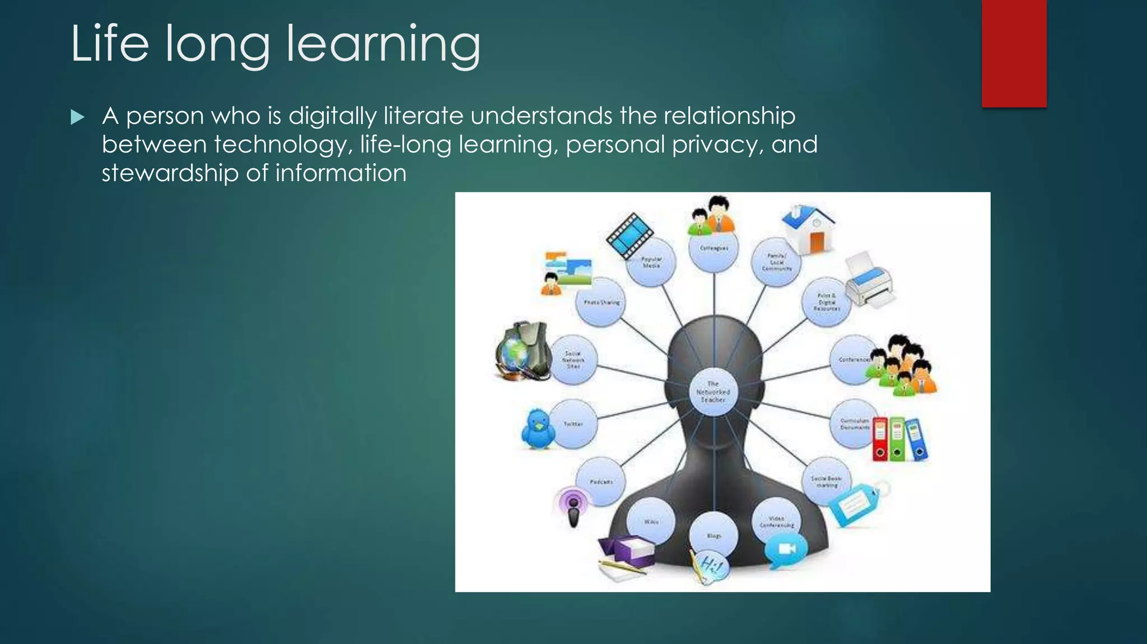
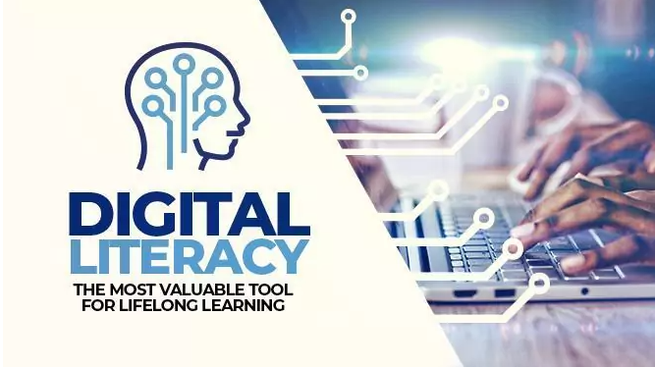
Life long learning
A person who is digitally literate understands the relationship between technology, life-long learning, personal privacy, and stewardship of information
“Digital literacy is the ability to identify and use technology confidently, creatively and critically to meet the demands and challenges of life, learning and work in a digital society”.

